Slide 1
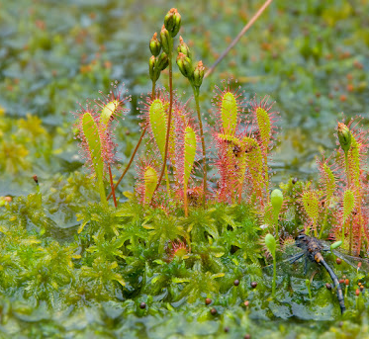
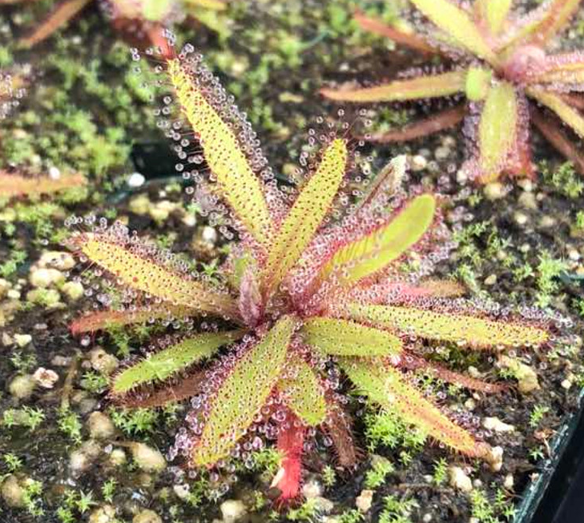
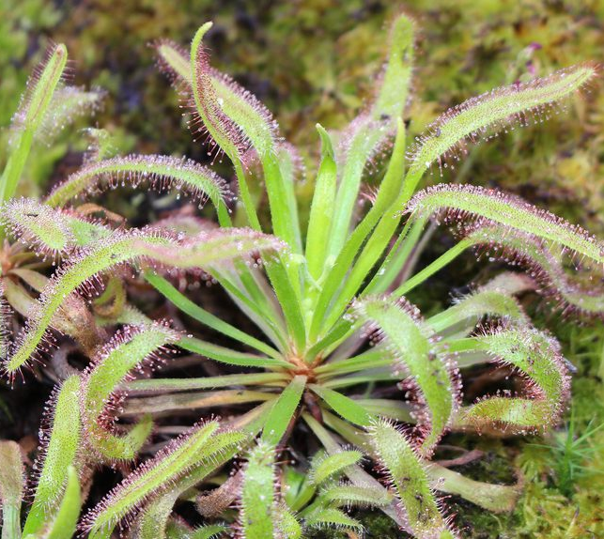
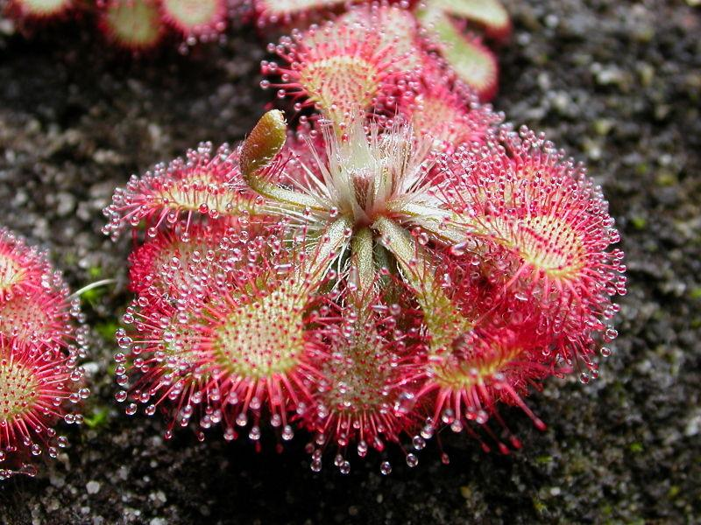

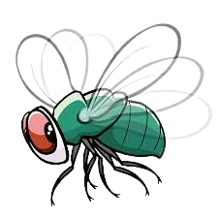
Sundews use their leaves to capture and eat their prey!
Click anywhere to continue
There are over one hundred types of sundews. Some have long, pointy leaves and others have short, round leaves.
Click anywhere to continue
This is a Sundew!
Click anywhere to continue
The leaves are covered in “tentacles” with a sticky substance on the tips to prevent insects from escaping.
Click anywhere to continue
Round Leaved Sundew
English Sundew
Drosera adelae
Drosera capensis

Slide 2
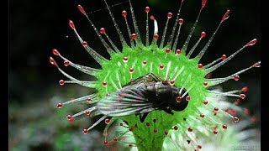

Check out this video of sundews in action
Click here to play the video
When finished,
click here to
return to The Bog!

Slide 3
You shouldn't be here!
Go back to the bog!!!

Slide 4
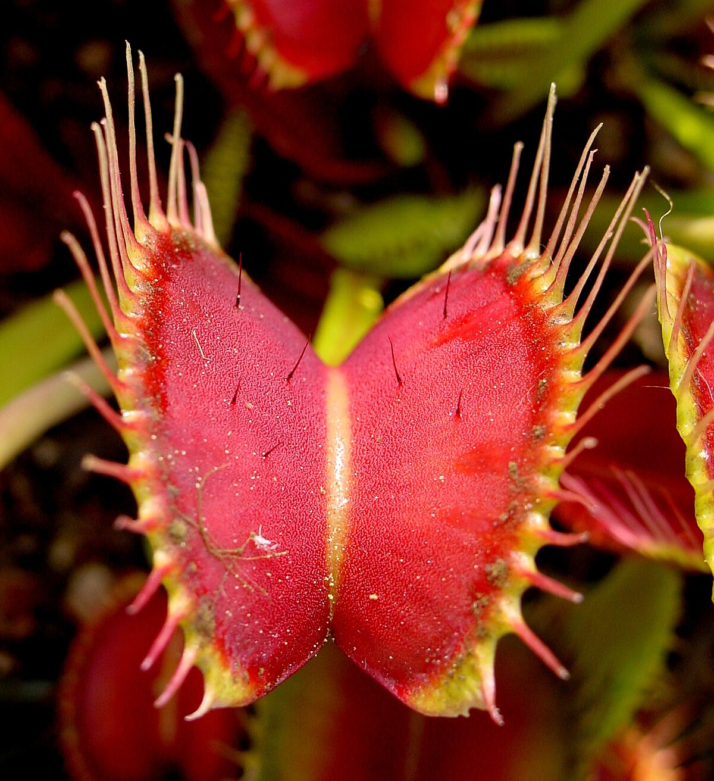
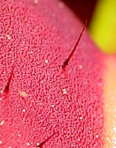
Venus Flytraps have “hairs” inside of their traps that cause the trap to close when something touches them.
Click the square to zoom in
This is a Venus Flytrap!
Click anywhere to continue
These traps can only open and close a few times before it dies. To prevent the plant from wasting energy, the traps only shut when the hairs are touched multiple times.
Click anywhere to continue

Slide 5
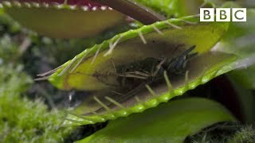
Let’s watch a Venus Flytrap catch its prey!
Click here to play the video
When finished,
click here to
return to The Bog!

Slide 6
You shouldn't be here!
Go back to the bog!!!

Slide 7
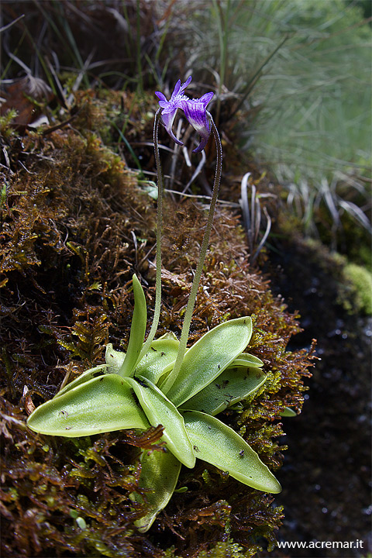
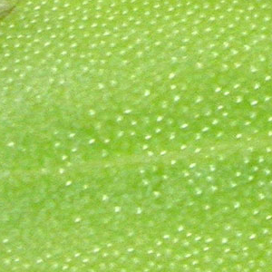

Butterworts have green sticky leaves that prevent their prey from escaping!
Click anywhere to continue
This is a Butterwort!
Click anywhere to continue
Mucilage is what attracts insects and makes the leaves sticky.
Click anywhere to continue

